Slide 1


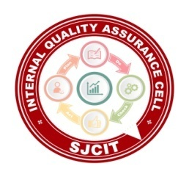
||Jai Sri Gurudev || Adichunchanagiri Shikshana Trust(R.) SJC INSTITUTE OF TECHNOLOGY An Autonomous Institution under VTU from 2024-25 AICTE Approved, Accredited by NBA(CSE,ISE,ECE,ME,CV,AE) NAAC with A+ grade, QS I-Gauge Gold rated P.B. No. 20, B.B. Road, Chikkaballapur- 562101, Karnataka.
Project- BCI685
On
“Intelligent Simulation Framework for Autonomous Vehicles ”
Presented by:
PRIYANSHU KUMAR
PUSHPAK CHAKRABORTY
RAJATH K M
TRUPTI GARWAD
DEPARTMENT OF ARTIFICIAL INTELLIGENCE & MACHINE LEARNING
Under the guidance of :
Prof. Muniraju M
Assistant Professor
Dept. of AI & ML, SJCIT

Slide 2
.
TABLE OF CONTENTS
Introduction
Abstract
Problem statement
Objective
Methodology

Slide 3
.
Introduction
The evolution of autonomous vehicles marks a transformative shift in modern transportation systems, aiming to enhance road safety, traffic efficiency, and passenger convenience. However, deploying such systems in real-world scenarios remains a formidable challenge due to the need for intelligent, adaptive, and robust decision-making capabilities. Achieving reliable navigation under dynamic traffic conditions requires more than just traditional path planning — it necessitates integration with advanced artificial intelligence techniques, reliable communication frameworks, and energy-aware sensor networks.
This project focuses on the development of a simulation-based framework that integrates multiple cutting-edge technologies to address these challenges. By combining Deep Reinforcement Learning (DRL), classical planning algorithms (A*, RRT*), Vehicle-to-Everything (V2X) communication protocols, and Wireless Sensor Network (WSN) optimization, the framework provides a holistic approach to adaptive path planning and cooperative autonomous driving. Simulation platforms such as CARLA, SUMO, and NS-3 are used to validate and demonstrate the effectiveness of this integrated system, ensuring scalability, responsiveness, and safety in highly dynamic environments.

Slide 4
.
Abstract
This project presents a simulation framework for addressing key challenges in autonomous vehicle navigation, including path planning,
communication, and energy efficiency.
Combines Deep Reinforcement Learning (DRL) with A* and RRT* for adaptive and deterministic path planning.
Integrates 5G-based V2X communication using groupcasting and IR-HARQ to enhance message reliability under delay and packet loss.
Optimizes Wireless Sensor Networks (WSNs) with Reinforcement Learning and MOISA(Multi-Objective Improved Seagull Algorithm) for energy-efficient clustering and routing.
Uses CARLA(CAR Learning to Act) and SUMO(Simulation of Urban MObility) for high-fidelity, realistic traffic and vehicle behavior simulations.
Implements Full Velocity Difference (FVD) model for passenger comfort and smooth driving.
Applies Signal Temporal Logic (STL) for runtime safety verification of vehicle decisions.
Aims to provide a modular, scalable, and safe simulation platform for testing real-world autonomous driving scenarios.

Slide 5
.
Problem Statement
Problem Statement:-
Enhancing autonomous vehicle performance requires a unified framework that integrates adaptive planning, formal safety, efficient V2X communication, and energy-aware decision-making. Combining these elements supports real-time, reliable, and sustainable operation in dynamic traffic environments.

Slide 6
.
Objective
The main goals of this project are:
Adaptive Path Planning: Develop a hybrid global-local path planning system using DRL and traditional planners (A*, RRT*) to respond to dynamic environments.
Vehicle-to-Vehicle Communication (V2X): Implement reliable 5G/6G-based communication using IR-HARQ and groupcasting for cooperative driving.
Real-Time Replanning: Integrate MPC for continuous trajectory adjustments in response to obstacles and route changes.
Comfort and Safety Control: Use Full Velocity Difference (FVD) model and feedback loops to ensure passenger stability and smooth motion.
Energy-Aware WSN Integration: Optimize sensor networks using reinforcement learning and clustering with MOISA for efficient energy use.
Formal Safety Verification: Apply Signal Temporal Logic (STL) to validate policy decisions and maintain adherence to safety constraints.

Slide 7
.
Methodology
The project will be implemented as a simulation-based system integrating the following modules:
Hybrid Path Planner:
Use A*/RRT* for initial path estimation.
DRL (e.g., PPO/SAC) for adaptive motion planning under uncertainty.
Replanning with MPC for local obstacle avoidance.
V2X Communication Module:
Develop groupcasting protocol with IR-HARQ retry schemes.
Implement packet delay/loss scenarios in SUMO + CARLA bridge.
Comfort and Control Module:
Integrate Full Velocity Difference (FVD) model with dynamic feedback gains.
Use STL to enforce safety zones and rule compliance.
WSN Energy Management:
Apply RL-based clustering and MOISA for energy optimization.
Use NS-2/NS-3 to simulate network load and routing dynamics.
Unified Decision and Logging Layer:
Build centralized integration logic.
Use STL-based runtime monitors to verify policy actions.

Slide 8
.
Design/Algorithm/Techniques Used
Deep Reinforcement Learning (PPO, SAC): Used for adaptive global path planning in dynamic environments.
A and RRT* Algorithms:* Classical techniques for initial path estimation and deterministic route generation.
Model Predictive Control (MPC): Applied for local real-time trajectory correction and obstacle avoidance.
Full Velocity Difference (FVD) Model: Ensures passenger comfort by minimizing acceleration and deceleration fluctuations.
Signal Temporal Logic (STL): Used for formal runtime verification of safety rules and behavioral constraints.
IR-HARQ-Based V2X Groupcasting: Enhances communication reliability and responsiveness between vehicles using 5G/6G.
MOISA (Multi-Objective Improved Seagull Algorithm): Optimizes energy-efficient routing and cluster formation in Wireless Sensor Networks (WSNs).

Slide 9
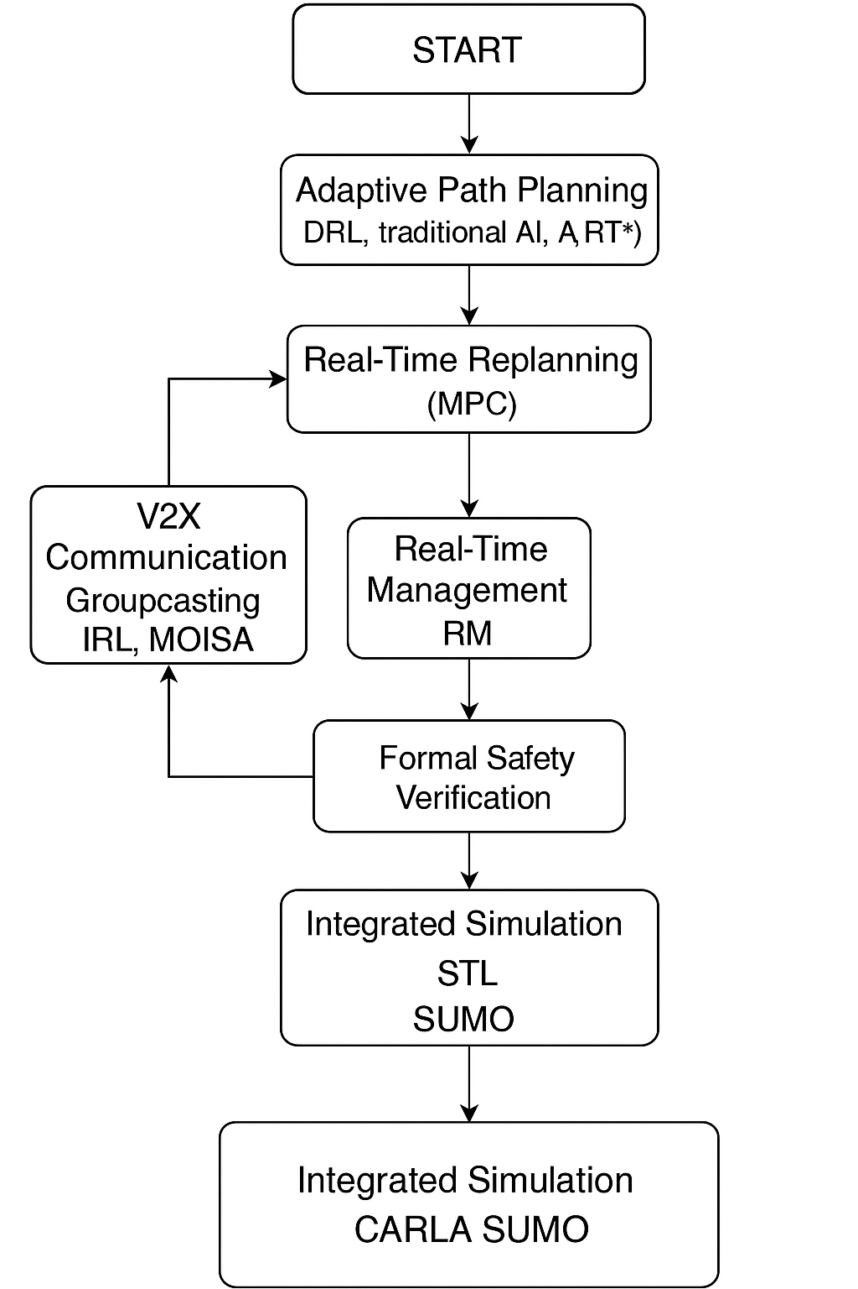
.
Flow Chart

Slide 10
Intelligent Simulation Framework for Autonomous Vehicles
THANK YOU

